Slide 1





EMPOWERING YOUR DIGITAL JOURNEY
DPIO: Your Digital Partner
SIMPLIFYING INNOVATION WITH STRATEGY, DESIGN, AND TECHNOLOGY
Notes:
"Good [morning/afternoon], everyone. Today, we’re diving into how DPIO acts as your trusted digital partner, transforming challenges into opportunities through innovation. By the end of this presentation, you’ll see how our strategic approach can empower your business’s digital journey.“
Delivery Tip:
Pause after the title to let it sink in.
Smile and make eye contact to establish rapport.

Slide 2







Challenges
Outdated Technology
Inefficient Processes
Lack of Strategy
High Operational Costs
Inability to Scale
Without a clear digital plan, businesses face confusion in their technological advancements.
Businesses struggle to grow effectively when technology doesn't support expansion efforts.
Many companies rely on obsolete systems, hindering their overall efficiency and growth.
Teams waste time on manual tasks, leading to decreased productivity and employee morale.
Legacy systems often incur excessive costs due to frequent maintenance and inefficiencies.
Notes:
"Let’s start with the challenges businesses face today. Many struggle with:
Outdated systems slowing down operations,
Inefficient processes draining resources,
And unclear digital strategies leaving them behind competitors.
These hurdles aren’t just frustrating—they’re costly. But this is where DPIO steps in.“
Engagement Tip:
Ask: "How many of you have faced similar challenges?" (Raise hands or nod.)

Slide 3



Digital Strategy
Custom Software
AI Solutions
We develop tailored strategies that align technology with business goals, ensuring a clear path to success in the digital landscape.
Our team creates bespoke software solutions designed to address unique business challenges, enhancing efficiency and boosting productivity through innovative technology.
We implement advanced AI and automation tools that streamline operations, reduce costs, and improve decision-making, positioning businesses for future growth.
Core Services Overview for DPIO
Notes:
"DPIO simplifies innovation through three core services:
Digital Strategy & Consulting: We align technology with your business goals—no more guesswork.
Custom Software Development: Tailored solutions that fit like a glove, not off-the-shelf bandaids.
AI & Automation: *Cut repetitive tasks by 50% or more, freeing your team for high-value work.*
Think of us as your Swiss Army knife for digital transformation.“
Delivery Tip:
Use hand gestures to "count" each service.
Pause after each point for emphasis.

Slide 4
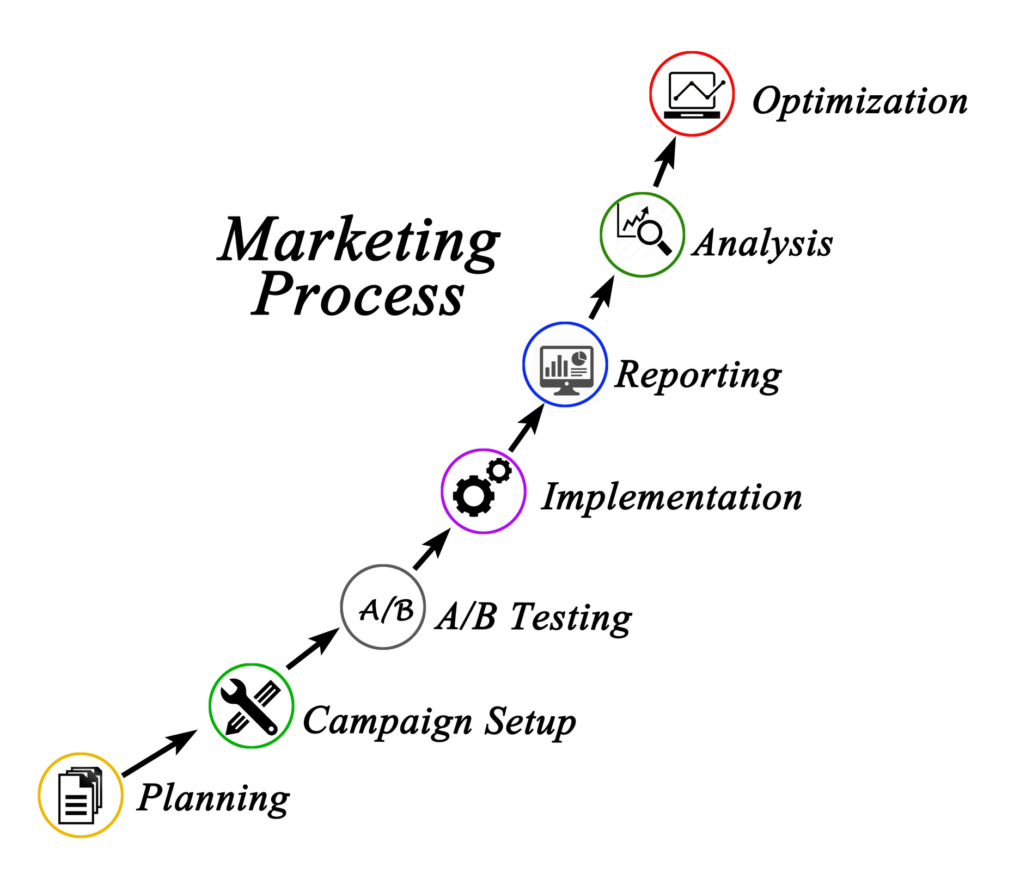

Our 4-Step Approach
Discover & Design
In the first two steps, we analyze needs and create tailored strategies for effective digital transformation.
Develop & Deploy
The final steps focus on implementing solutions and ensuring smooth integration and ongoing support for clients.
Notes:
"Our approach is methodical:
Discover: We audit your current systems and listen to your pain points.
Design: Co-create a blueprint with your team—no one-size-fits-all.
Develop: Build solutions with agility, keeping you in the loop at every stage.
Deploy: We don’t just launch and leave. We ensure smooth adoption and ROI.
This isn’t just a process; it’s a partnership.“
Engagement Tip:
Point to each step as you explain it.
Share a quick anecdote: "For example, one client saw ROI in 3 months thanks to this phased approach."

Slide 5
Why Choose DPIO?
Transformative Solutions
Without DPIO, businesses often face chaos and inefficiency, leading to missed opportunities and increased costs. Outdated systems and unclear strategies hinder progress and stifle innovation.
Notes:
"Why DPIO? Let’s compare:
Without us: You’re stuck with fragmented tools, rising costs, and missed opportunities.
With us: You get a seamless, scalable tech stack that grows with your business.
We bridge the gap between where you are and where you want to be.“
Delivery Tip:
Use a contrast tone: Frustrated for "Without," confident for "With."

Slide 6


Client Success
Our collaboration with Aboriginal Counseling Services of Alberta highlights the strength of AI-driven solutions. By streamlining their processes, they achieved significant results, including a 40% cut in costs. This case study emphasises the role of innovative technology in today's market landscape.
Further, the adaptability of our strategies allowed ACSA to enhance productivity and boost efficiency.
With our support, they are now positioned for sustained growth and future innovations.
This success story serves as a testament to DPIO's commitment to delivering effective transformation.
Notes:
"Proof is in the results. Take ACSA, who partnered with us for AI-driven process optimization. Together, we achieved:
40% reduction in operational costs,
Streamlined workflows that boosted productivity,
And a future-proof foundation for innovation.
This isn’t just about technology—it’s about impact.“
Engagement Tip:
Highlight adaptability: "ACSA’s success wasn’t magic; it was the right strategy, executed flexibly."
Pause before the 40% stat for dramatic effect.

Slide 7


“Unlock your potential and embrace the future of innovation.”
– DPIO Team
Notes:
"Now, imagine what DPIO could do for your organization. Whether it’s cost savings, efficiency, or innovation, we’re here to make it happen. Let’s discuss how we can tailor our services to your needs. Scan the QR code to book a consultation, or reach out directly—we’re excited to collaborate.“
Delivery Tip:
End with energy: "Thank you—let’s build something remarkable together."
Hold eye contact with key stakeholders.

